Slide 1
Network Forensics
How to sniff……traffic

Slide 2
Careers
Entry Level:
SOC Analyst I ($60k - $90k/year)
Forensic Analyst ($70k-$90k/year)
Experienced:
Forensic Investigator ($120k+/year)
Popular Companies
Cellebrite
MSAB
Magnet Forensics
FBI
CIA

Slide 3
Network Forensics
Network forensics is a subcategory of digital forensics that essentially deals with:
examination of the network and its traffic going across a network that is suspected to be involved in malicious activities,
its investigation
for example a network that is spreading malware for stealing credentials or for the purpose analyzing the cyber-attacks.
SO basically look at logs and find stuff that isnt normal
What are things you would expect to see in a network?
What might be things that you wouldnt expect to see in a network (aka what would be sus)?
IOC’s
Anyone?
Notes:
Expect: DNS requests, FTP, HTTP to normal sites, ARP
SUS: HTTP downloads, tons of ARP requests right next to each other, Massive amounts of PING (ICMP) scans

Slide 4


How do we analyze this traffic? How do we sniff out this bad traffic?
WireShark!

Slide 5
Wireshark: Open Source Packet Analysis
Deep inspection of hundreds of Protocols
Live Capture and offline analysis
Capture files from http requests
Decryption Support for many protocols
Colors!
Source: https://www.wireshark.org/about.html

Slide 6
BUT before we…….dive…..in, how do we even get the network traffic
Three (most likely more) ways:
Using Wiresharks default capture feature
Tcpdump
Can be run in Promiscuous Mode
Who is in networking? Tell me what this is
Available on most if not all linux distros and windows
Its given to you

Slide 7
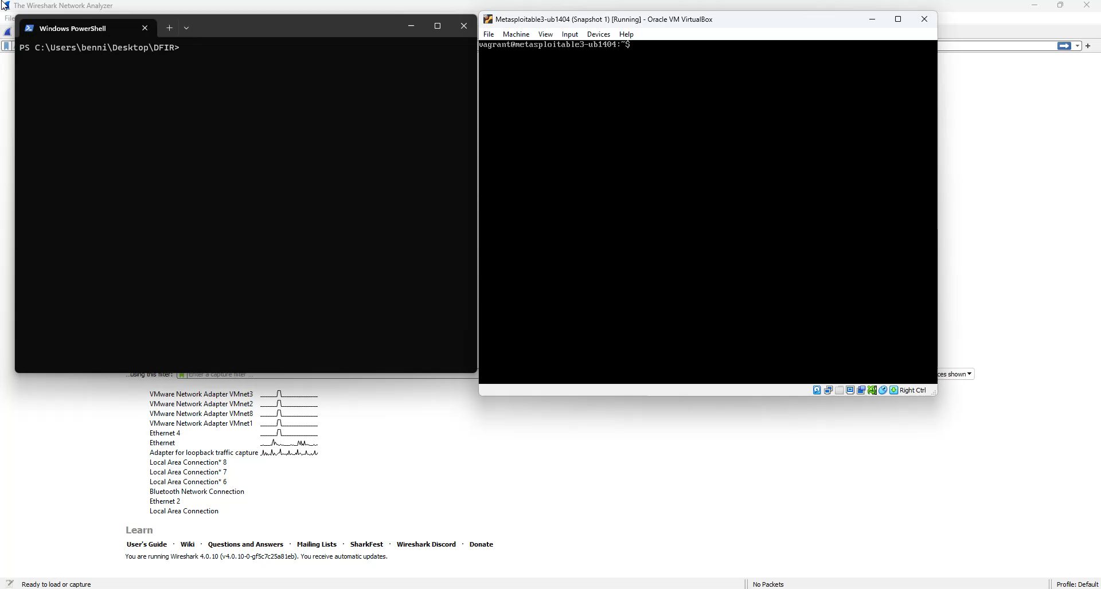

Slide 8
Wireshark Key Features
Filters
Statistics
Analyze
Decryption/Decode
Follow
Plugins

Slide 9
WShark: Filters
Autofill
Right Clicking
Pre-Capture filter
Worth it? What do you think?
Pros
Cons
Filter Buttons
Coloring
View –> Coloring Rules
<DEMO>

Slide 10
WShark: Statistics
Offers Overview of general conversations
Shows you IP addresses communicating on your network
MAC Address lookups
Why might IP and MAC addresses be nice to see when analyzing network traffic?
Shows downloaded (requests) files
VirusTotal.com

Slide 11
Wireshark Key Features: Statistics

Slide 12
WShark: Analyze
Useful but more niche than anything
Useful feature is adding new columns and using some decode features

Slide 13
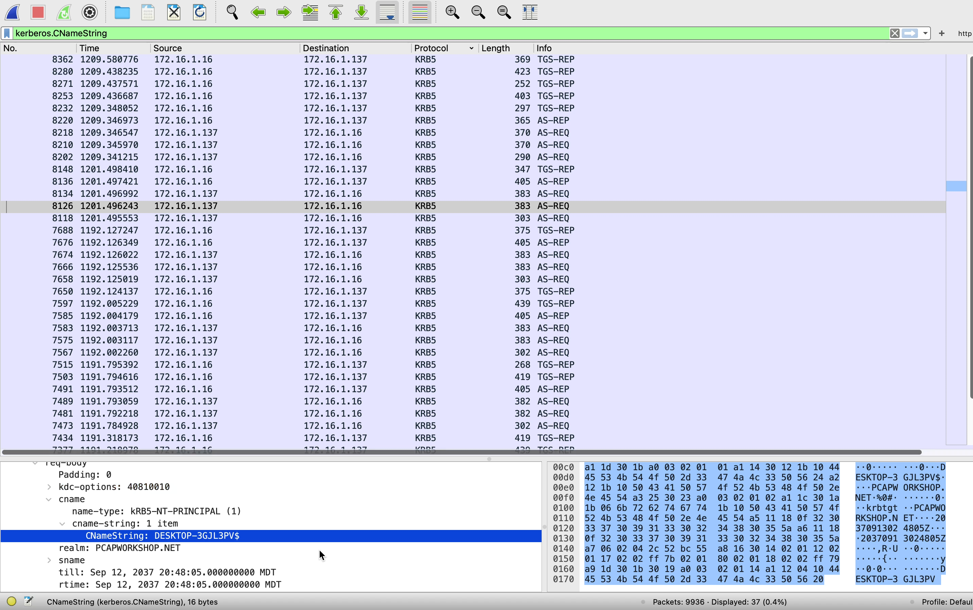

Slide 14
WShark: Follow
Shows conversations between the subset of indicators
Helps narrow down connections
Investigating Urls
UrlScan.io?
Why would we use this?

Slide 15
WShark: Decryption
Assign environment variable
Windows:
Open Admin powershell
$ cd /Users/<your user>/Destkop
$ SetX SSLKEYLOGFILE “$(get-location)\ssl.log”
$ Get-ChildItem ENV: | findstr SSLKEYLOGFILE
Remove when done
$ Remove-Item -Path Env:\SSLKEYLOGFILE
Mac/Linux:
Open terminal
$ cd /Documents
$ export SSLKEYLOGFILE=$PWD/keylog.log
$ open /Applications/Google\ Chrome.app/
Env will only last for terminal session
Use ssl_log to decrypt https in Wireshark
Preferences/Settings -> Protocols -> TLS -> Upload ssl-key.log

Slide 16
Activity: Analyzing Real-World Packet Captures
For challenges, see #dfir-emphasis
Good Luck Have fun
Ask Emmie, Josh, or I for help! We want to you to have fun and learn more about network forensics!

